Slide 1
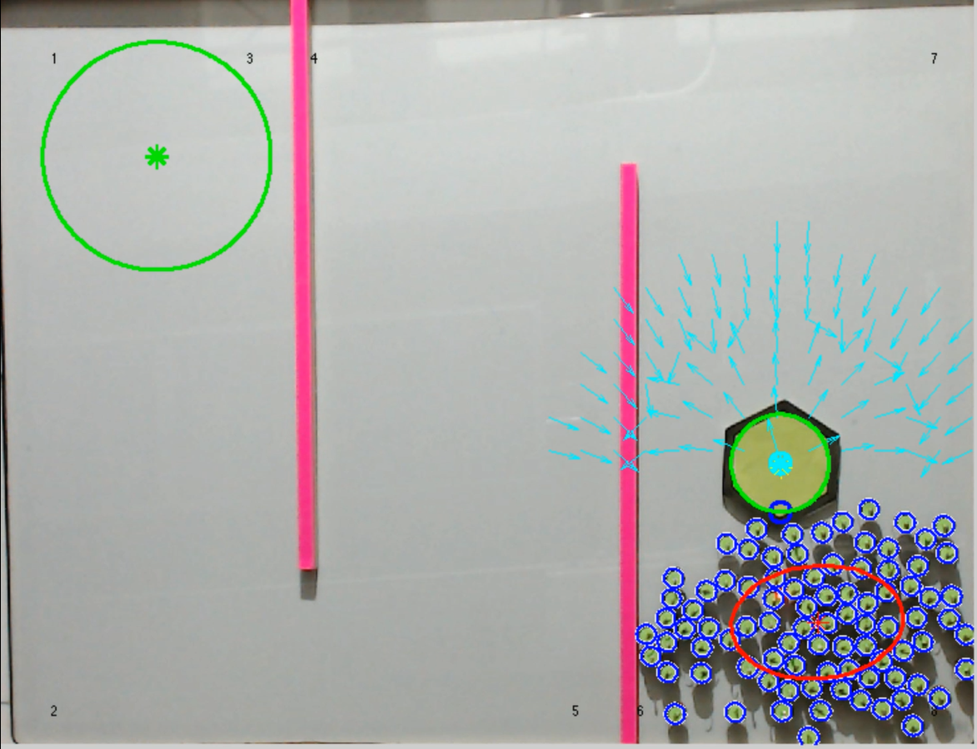
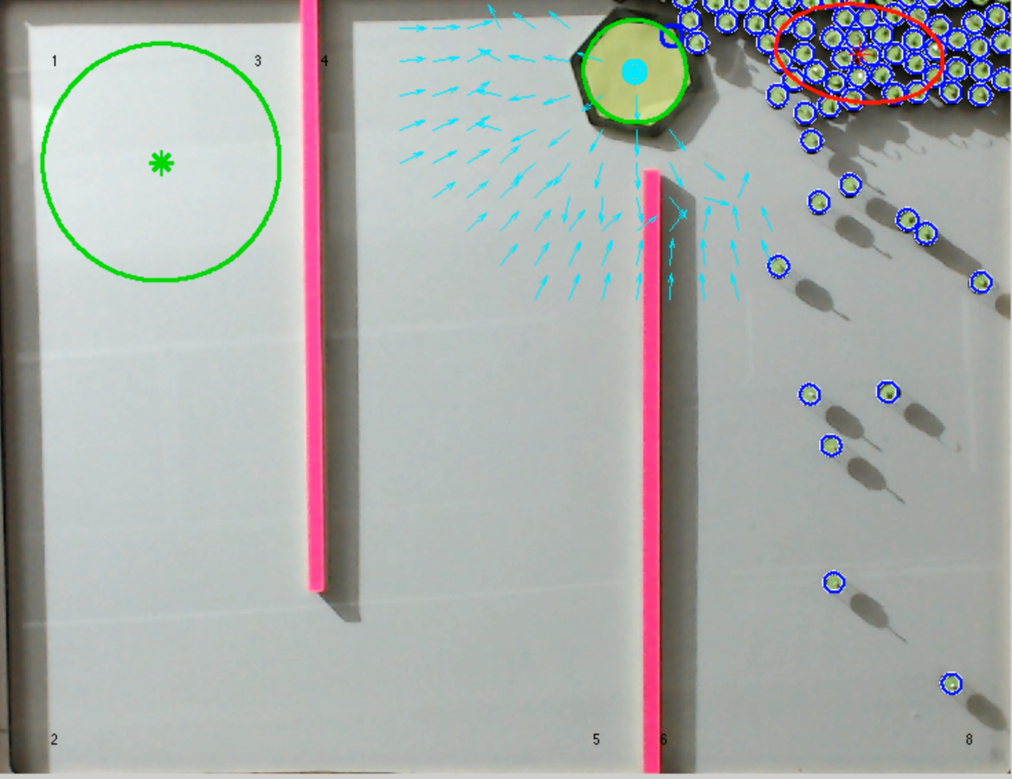
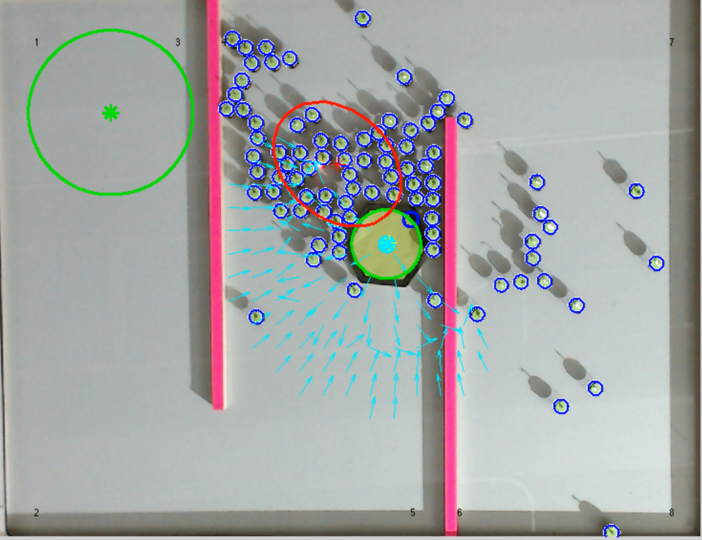
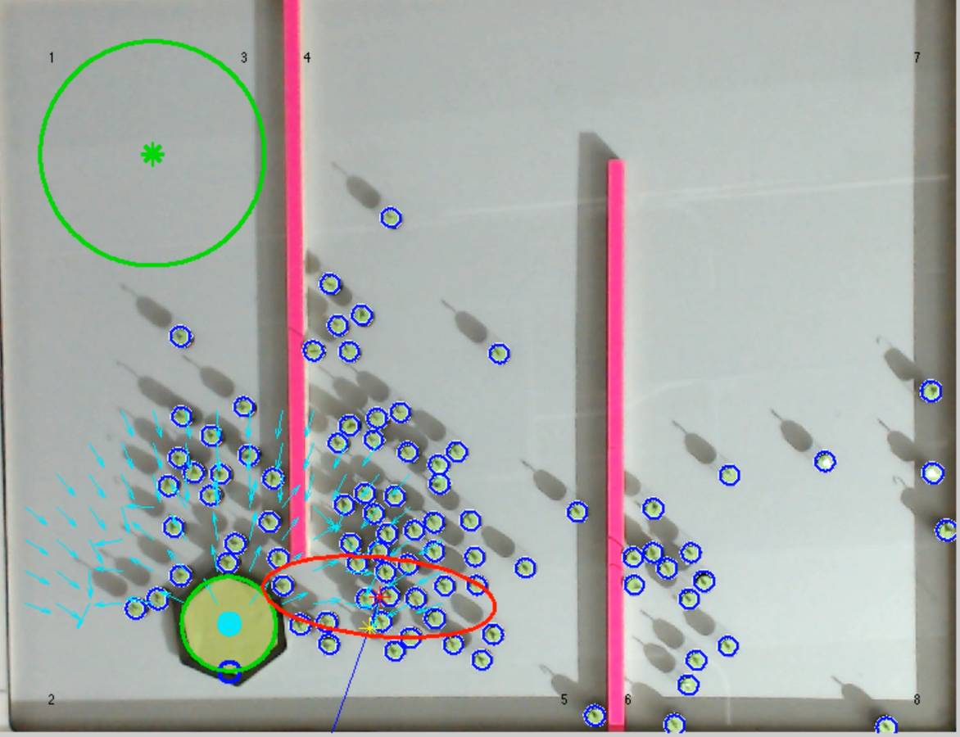
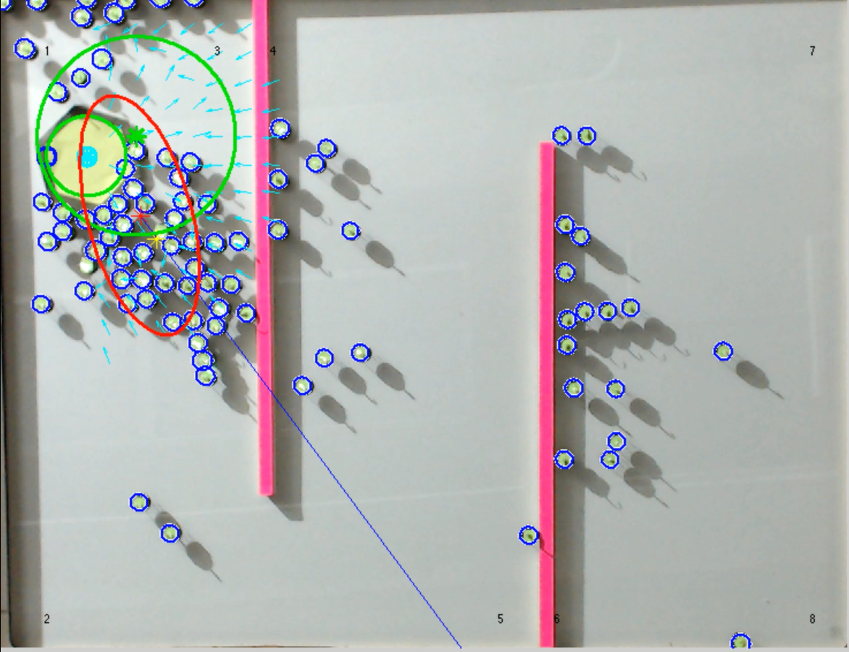
T = 0.05 s
T = 6.83 min
T = 11.9 min
T = 22.9 min
T = 45.05 min
Notes:
Or time as follows 3 seconds, 6 minutes and 50 seconds, 11 minutes and 54 seconds, 22 minutes and 54 seconds, and 45 minutes and 3 seconds

